Slide 1
P10: Chat-Bot
Natural Language Processing Project
Mamidi Baby Soumya
Mentored By: Udit Dharmin Desai
Supervised By: Prof. Sudeshna Sarkar

Slide 2
Table of Contents:
Introduction
Corpus
Libraries Used
Approach
How to Run the Code
References

Slide 3
Introduction:
Corpus:
In this project we have implemented Medibot! which is a chatbot that can converse on
health topics such as what are various diseases and how to cure those diseases.
The corpus is made with the informations parsed from this website:
https://www.niams.nih.gov/health-topics/all-diseases
Corpus link: data
Libraries Used:
We have used NLTK, SKLearn,Random,String etc to implement this
Project.

Slide 4
Approach:
The corpus contains details about various diseases and cures/treatments of those diseases. The main task of the chatbot is to get the query from the user and get the sentence from the corpus which best matches the query.
For this we first splitted the corpus into sentences using sent_tokenize. Next step was to tokenize those sentences into words. Then we preprocessed those words by removing stopwords and applied stemming and lemmatization.
Next step was to convert those sentences into vectors to calculate similarity. For vector representation we used “Bag of words”,which doesn’t take into consideration the order of occurrence of the words.
Then we scaled the vectors by using TF-IDF values. Where TF denotes the term frequency of a word. And IDF is Inverse Document Frequency, DF represents in how much documents the word has occurred. This scaling was required mainly because there are Words which occurs many times have less significance than words which occurs less.

Slide 5
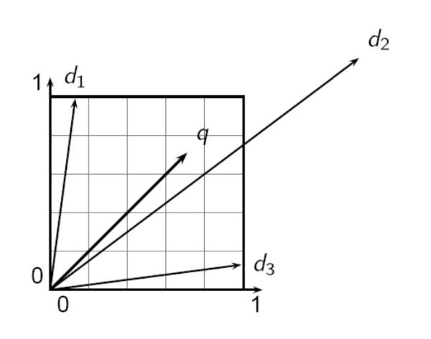
Continued...
Now after generating vectors from all the Sentences and also
from the query , our task was to get the sentence vector
which is closest to query vector. For this we used cosine
similarity.
If we are Unable to find any similarity between the query and
corpus sentences, then we simply printed out
“I am sorry! I don't know about this disease”.
In case if the user uses any greetings then we handled it differently.

Slide 6
How to Run The Code:
First Download the Python Notebook file from this link: ipynb file
Then Download the corpus from this link: data
Import the code in Google Colab or Jupyter Notebook. Change the data file path accordingly. Run all the cells.
Let’s say X is a disease. Then you can ask questions like “What is X disease?” or “How to cure X?” or “How to do Treatment of X?” . If X is in Corpus, then the chatbot will reply with the Information about that Disease.

Slide 7
References
https://heartbeat.comet.ml/building-a-conversational-chatbot-with-nltk-and-tensorflow-part-1-f452ce1756e5
https://landbot.io/blog/natural-language-processing-chatbot
https://towardsdatascience.com/how-to-build-a-chatbot-a-lesson-in-nlp-d0df588afa4b

